Slide 1



THINK-ON-GRAPH: DEEP AND RESPONSIBLE REASONING OF LARGE LANGUAGE MODEL ON KNOWLEDGE GRAPH
Authors: Jiashuo Sun,Chengjin Xu,Lumingyuan Tang, Saizhuo Wang,Chen Lin,Yeyun Gong,Lionel M. Ni,Heung-Yeung
Publisher: ICLR(International Conference on Learning Representation) 2024
汇报人：张文亮
Notes:
1国际数字经济研究院IDEA Research 2厦门大学3南加州大学4香港科技大学5香港科技大学（广州）6微软亚洲研究院

Slide 2
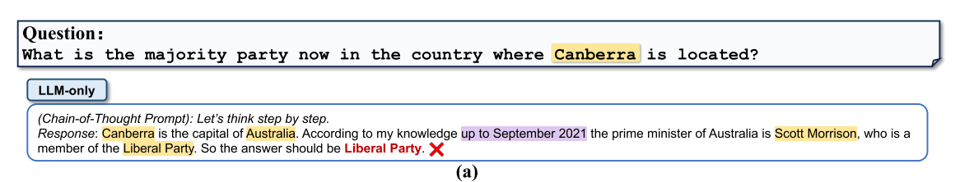
1
Introduction
Large language models (LLMs) have demonstrated remarkable performance across various natural language processing tasks.
Despite their impressive performance, LLMs has the following limitations：
1）LLMs usually fail to provide accurate answers to questions requiring specialized knowledge beyond what was included in the pre-training phase , or to questions requiring long logic chain and multi-hop knowledge reasoning.
2） LLMs lack responsibility, explainability and transparency raising concerns about the risk of hallucinations or toxic texts.
3）the training process for LLMs is often expensive and time-consuming, making it challenging to keep their knowledge up to date.
自强不息 厚德载物
Central South University
Notes:
流行的点云 CNN模型

Slide 3
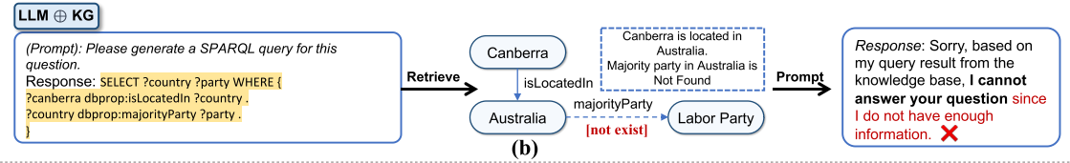
1
Introduction
Recognizing these challenges, a natural solution is to incorporate external knowledge such as knowledge graphs (KGs) to help improve LLM reasoning. These approaches follow a routine: retrieve information from KGs, augment the prompt accordingly, and feed the increased prompt into LLMs . This is refered to this paradigm as “LLM⊕KG”.The loose-coupling LLM⊕KG paradigm has its own limitations, and its success depends heavily on the completeness and high quality of KG.
In Figure b, although LLM successfully identified necessary relation types required to answer the question, the absence of the relation “majority party” leads to a failure in retrieving the correct answer.
自强不息 厚德载物
Central South University
Notes:
KGs offer structured, explicit, and editable representations of knowledge, presenting a complementary strategy to mitigate the limitations of LLMs .
Researchers have explored the usage of KGs as external knowledge sources to mitigate hallucination in LLMs. Although aiming to integrate the power of LLM and KG, in this paradigm, LLM plays the role of translator which transfers input questions to machine-understandable command for KG searching and reasoning, but it does not participate in the graph reasoning process directly.

Slide 4
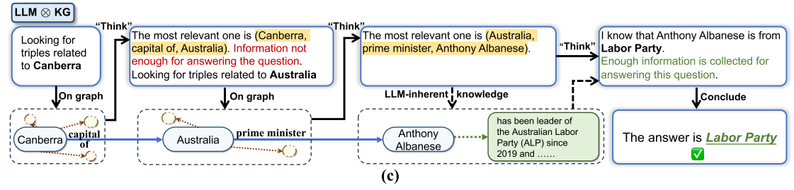
1
Introduction
The author propose a new tight-coupling “LLM ⊗KG” paradigm where KGs and LLMs work in tandem. Figure c provides an example illustrating the advantage of LLM ⊗KG. In this way, the LLM succeeds in generating the correct answer with reliable knowledge retrieved from KGs. As an implementation of this paradigm, author proposes an algorithmic framework “Think-on-Graph” (abbreviated as ToG below). Using the beam search algorithm in KG/LLM reasoning .
自强不息 厚德载物
Central South University
Notes:
Building upon these considerations, complementing each other’s capabilities in each step of graph reasoning In this example, the missing relation "majority party" resulting in the failure in Figure 1b can be complemented by a reference triple (Australia, prime minister, Anthony Albanese) discovered by the LLM agent with dynamic reasoning ability (, as well as the political party membership of Anthony Albanese coming from LLM’s inherent knowledge. meaning: LLMs “Think” along the reasoning paths “on” knowledge “graph” step-by-step, , for deep, responsible, and efficient LLM reasoning ToG allows LLM to dynamically explore a number of reasoning paths in KG and make decisions accordingly. Given an input question, ToG first identifies initial entities and then iteratively calls the LLM to retrieve relevant triples from KGs through exploration and reasoning until adequate information through the top-N reasoning paths in beam search is gathered to answer the question or the predefined maximum search depth is reached.

Slide 5
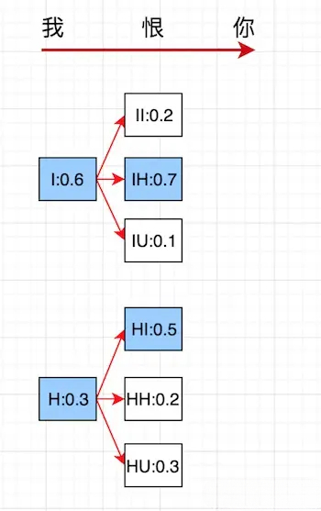
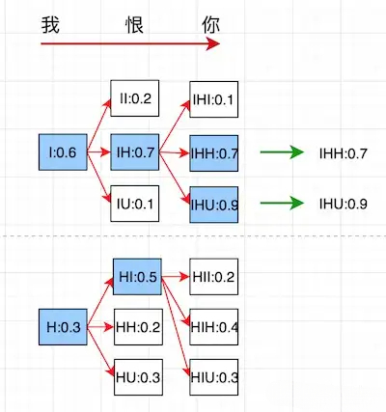
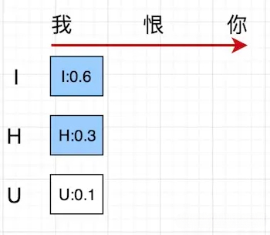
2
Method
beam search algorithm
Chinese input："我" "恨" "你"
English output："I" "H" "U"
beam size: k = 2
step1
step2
step3
自强不息 厚德载物
Central South University
Notes:
对数似然

Slide 6
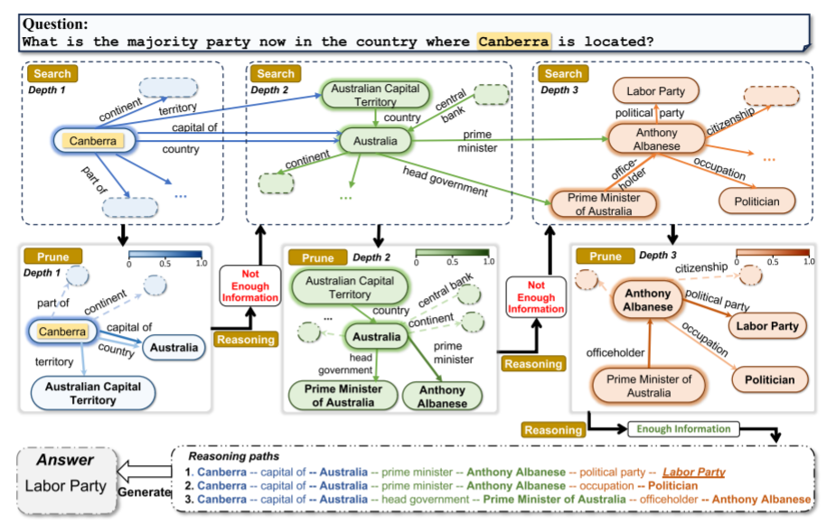
2
Method
THINK-ON-GRAPH
1)Initialization of graph search
2)Exploration
3)Reasoning
自强不息 厚德载物
Central South University
Notes:
首先是利用大模型获得问题中的主要实体，然后关系探索和实体探索（beam search 束搜索），这个过程是迭代的，就以图中所示为例，Canberr，把与Canberra相关的关系都找出来，然后进行一个剪枝，选择最相关的TOPN关系进行保留，其余剪枝，接着进行实体探索，找到TOPN关系的一个尾部实体，然后会得到相应的路径，接着会提示LLM评估当前推理路径是否足以生成答案。如果产生消极的评估结果 not Enough Information 则 继续进行搜索，直到评估结果为积极的或达到最大搜索深度Dmax，达到最大搜索深度Dmax，ToG仍无法探索出解决问题的推理路径。在这种情况下，ToG将完全根据LLM中的固有知识生成答案，如果产生积极的评估结果 Enough Information，就提示LLM以查询为输入，使用推理路径生成答案。

Slide 7
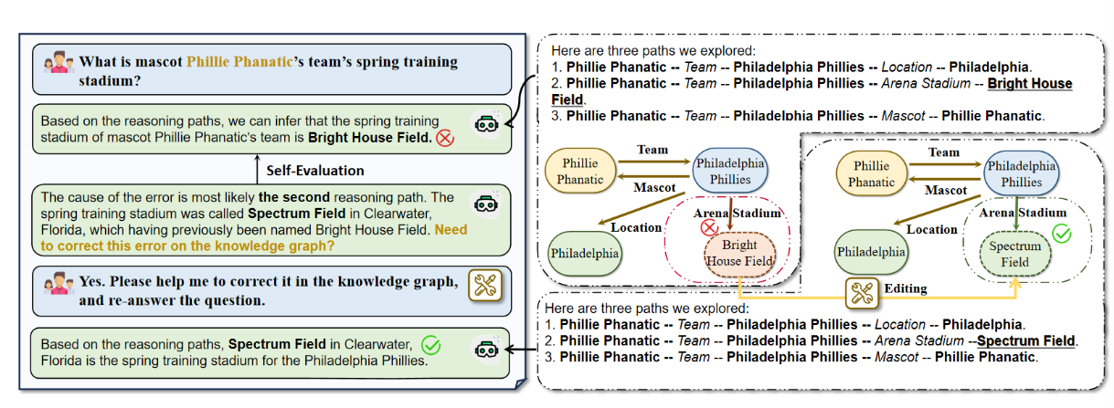
2
Method
The illustration of knowledge traceability and correctability of ToG
自强不息 厚德载物
Central South University
Notes:
KG的质量对于ToG的正确推理是非常重要的。ToG的一个有趣的特点是在LLM推理过程中具有知识可追溯性和知识可修正性，它提供了一种利用ToG本身来提高KG质量和降低KG构造和修正成本的方法。如图4所示，可以向用户显示ToG的显式推理路径。如果人类用户/专家或其他LLM发现了ToG答案中的潜在错误，ToG就有能力追溯并检查推理路径，找到有错误的可疑三元组，并纠正它们。以图4中的情况为例。给定输入问题“吉祥物Phillie Phanatic的球队的春训体育场是什么？"，ToG在第一轮中输出错误答案“Bright House Field”。然后ToG回溯所有的推理路径，定位错误的原因可能来自第二条推理路径（Phillie Phanatic Team − → Philadelphia Phillies竞技场Stadium −−→ Bright House Field），并分析错误来自过时的三元组（Philadelphia Phillies，竞技场Stadium，Bright House Field）中“Bright House Field”的旧名“Specturm Field”。根据ToG的提示，用户可以要求LLM更正此错误，并使用正确的信息回答相同的问题。这个例子揭示了ToG不仅用KG增强了LLM，而且用LLM改进了KG的质量，这被称为知识注入（Moiseev等人，2022年）的报告。

Slide 8
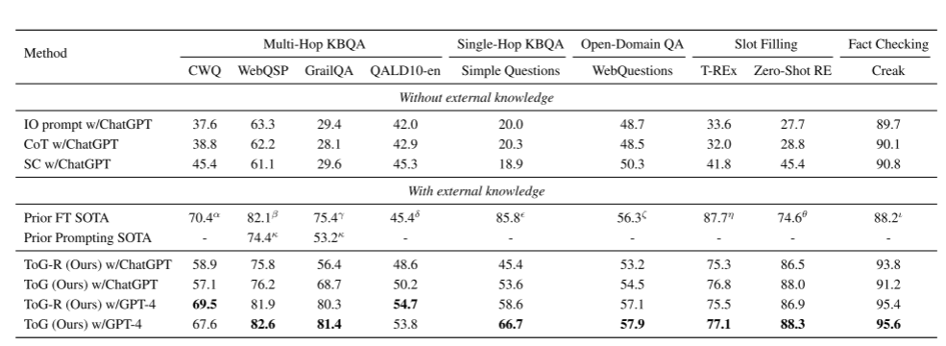
3
Experiments
The ToG results for different datasets
自强不息 厚德载物
Central South University
Notes:
多个问答（QA）和信息抽取任务数据集上的性能比较 用GPT模型微调的代码生成器codeX y
输入文本，让模型生成相应的输出。这种方法不涉及复杂的推理
SC自洽性方法旨在通过生成多个回答并选择最一致的回答来提高模型的回答质量和准确性

Slide 9
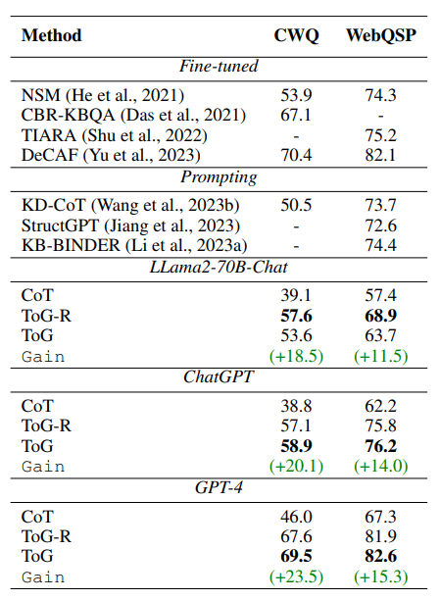
3
EXPERIMENTS
Performances of ToG using different backbone models on CWQ and WebQSP
自强不息 厚德载物
Central South University
Notes:
在多跳问答数据集

Slide 10
3
CONCLUSION
The advantage of ToG：
(1) Deep reasoning (2) Responsible reasoning (3) Flexibility and efficiency
The LLM ⊗ KG paradigm for integrating LLMs and KGs and propose the Think-on-Graph (ToG) framework, which leverages LLM as an agent participating in KG reasoning for better decision-making. Experimental results demonstrate that ToG outperforms existing fine-tuning-based methods and prompting-based methods without additional training cost and mitigates the hallucination issue of LLMs.
自强不息 厚德载物
Central South University
Notes:
提取出多样的多跳推理路径，作为LLM推理的基础，增强了LLM对知识密集型任务的深度推理能力 ToG在不增加训练代价的情况下，性能优于现有的基于微调的方法和基于自适应的方法，并减轻了LLM的幻觉问题
ToG是一种即插即用的框架，可以无缝地应用于各种LLM和KG
总的来说，利用LLM作为代理参与KG推理以获得更好的决策，
ToG优于现有的基于微调的方法和基于Prompt的方法，而无需额外的训练成本，并减轻了LLM的幻觉问题。

Slide 11

Thanks For Listening
Notes:
近似：在这篇论文中，不再优化SOTA采样器和邻居搜索器以减少执行延迟（在此基础上进行改进），而是决定通过简单地从“结构化”点云中选择具有适当索引的点，从而近似采样点以及它们的邻居
启发，借鉴2D图像的方法用于3D点云很有创造性 而和SOTA的采样和邻居搜索完全不同

